Slide 1






2025 SPARK ACADEMY
TRAIN FOR CHANGE, FROM SCIENCE TO PRACTICE
THE SPRINT AI TRAINING FOR AFRICAN MEDICAL
Imaging Knowledge Translation (SPARK)
Academy
IN DEEP LEARNING & MEDICAL IMAGING
REGISTRATION ON FOURWAVES
FEBRAURY 22 2025

Slide 2

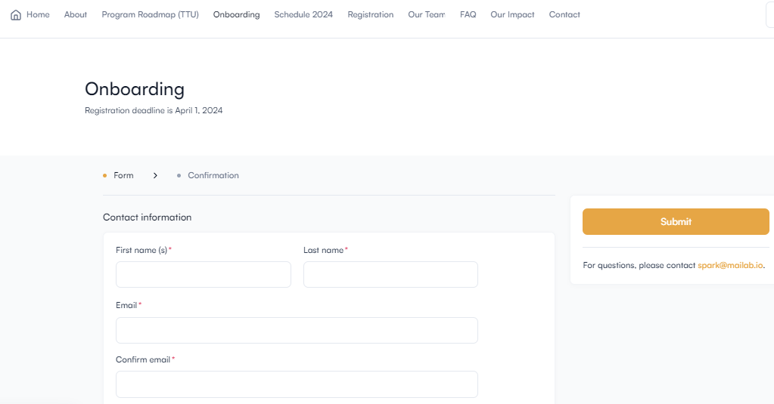
Creating Fourwaves Account
Platform
Register on the SPARK Program Platform
Head to the SPARK Program platform and complete the registration form to register. https://event.fourwaves.com/spark/registration
Submit the registration form.
https://event.fourwaves.com/spark
Notes:
Hi Everyone,
My name is Confidence Raymond
I will be talking on the the impact of SPARK Academy over a period of two years.

Slide 3
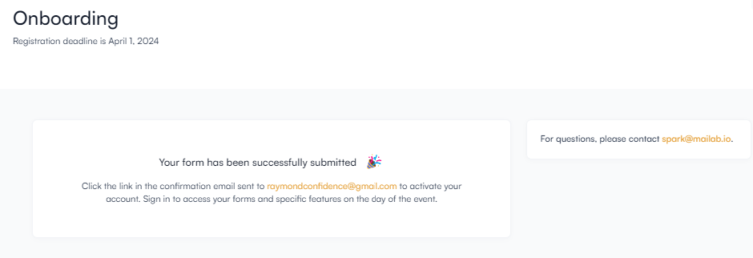
Creating Fourwaves Account
Platform
Register on the SPARK Program Platform
Head to the SPARK Program platform and complete the registration form to register. https://event.fourwaves.com/spark/registration
Submit the registration form.
Check your email for the registration confirmation email
https://event.fourwaves.com/spark

Slide 4
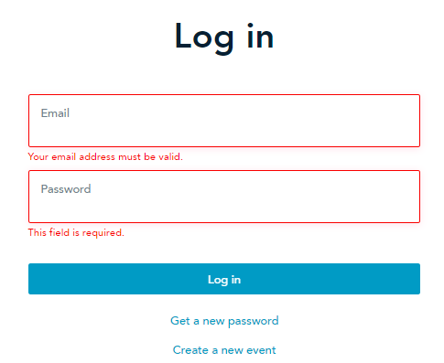
Creating Fourwaves Account
Platform
Register on the SPARK Program Platform
Head to the SPARK Program platform and complete the registration form to register. https://event.fourwaves.com/spark/registration
Submit the registration form.
Check your email for the registration confirmation email
Click the link on the registration confirmation email to activate your Fourwaves account and create your log in details.
Login to the SPARK`s Fourwave platform to access all resources.
https://event.fourwaves.com/spark
Notes:
Hi Everyone,
My name is Confidence Raymond
I will be talking on the the impact of SPARK Academy over a period of two years.

Slide 5

Fourwaves Live App
Platform
Click Link to Access Live App
Use Fourwaves’ Live APP on your mobile devices and desktop for live event participation and participant interaction.
https://event.fourwaves.com/spark
Notes:
Hi Everyone,
My name is Confidence Raymond
I will be talking on the the impact of SPARK Academy over a period of two years.

Slide 6
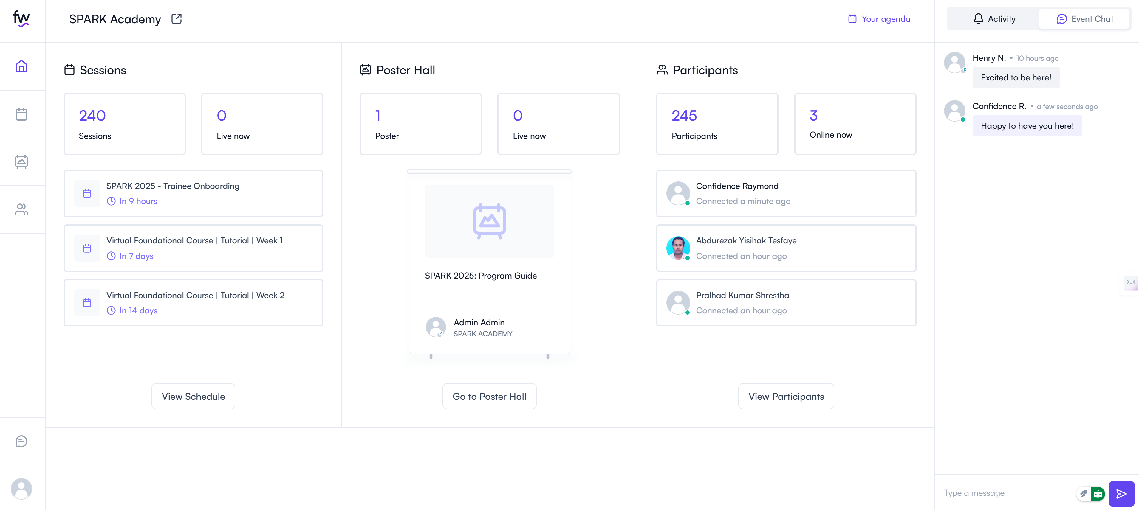
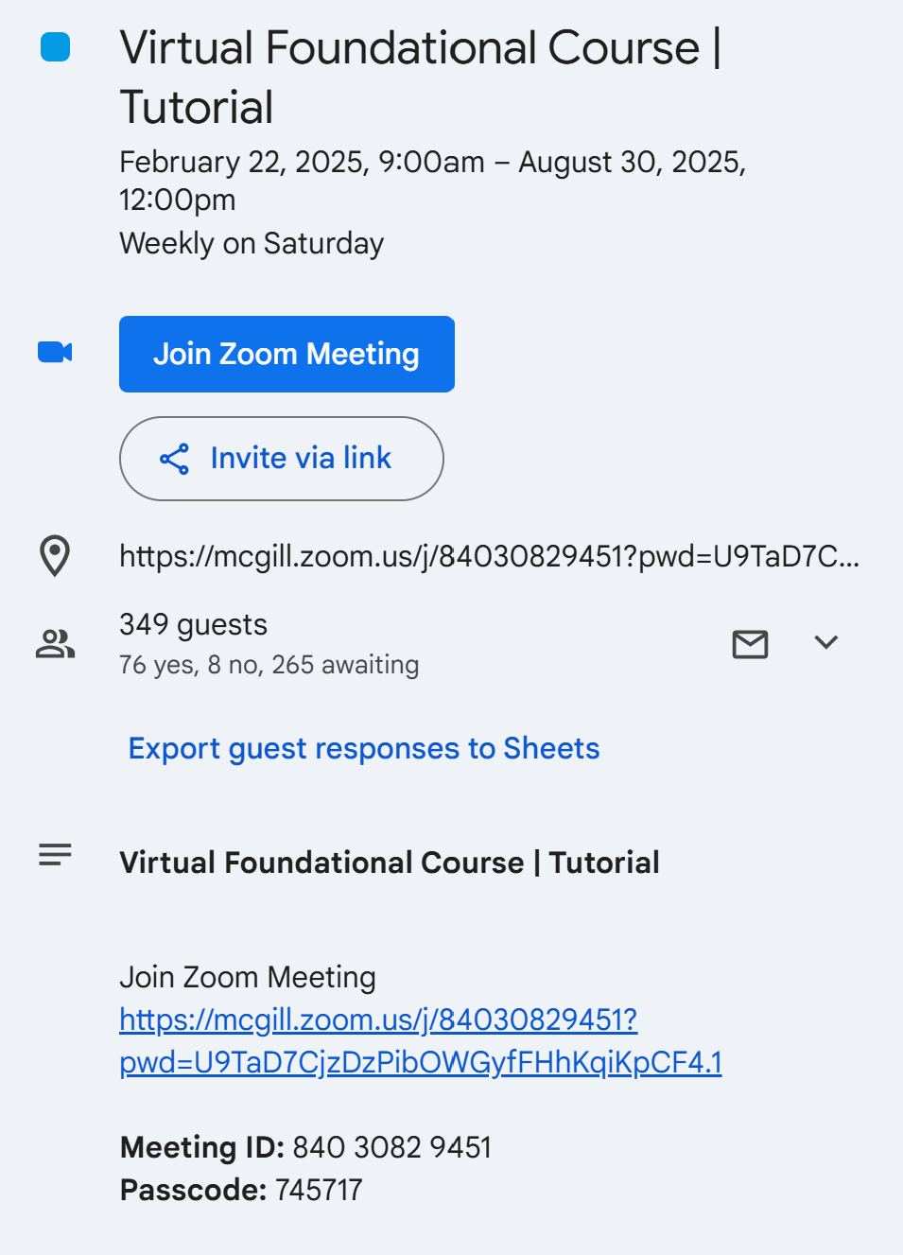
Fourwaves Live App
Live App
Mid-week and Weekend Team meeting
Live Interactions, chat, and connection
https://event.fourwaves.com/spark

Slide 7
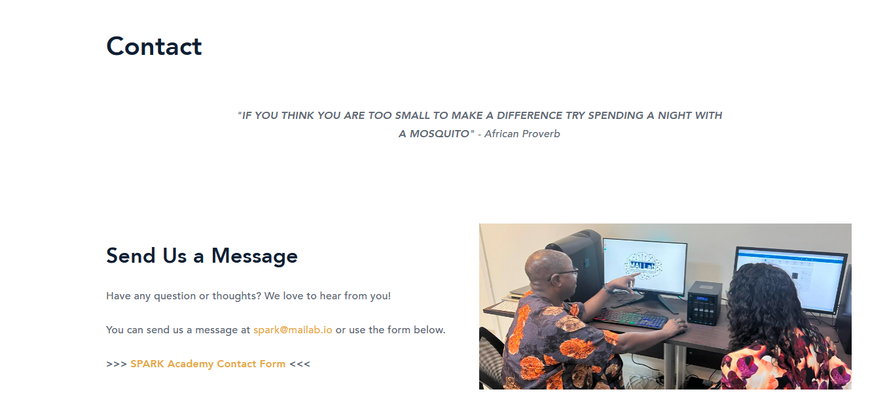
FAQ and Contact Information
YOUR TEAM COORDINATOR IS YOU FIRST POINT OF CONTACT
Contact
For general program information, consult the FAQ section of the training platform in Fourwaves.
For general program inquiry, contact the SPARK Academy team at spark@mailab.io.
For project specific information or questions related to your team assignment, hackathon project or team’s BraTS project, contact your Team Supervisor.
For all other program related inquiries, contact the SPARK Academy team at spark@mailab.io
Socials: Follow us for up-to-date program information
https://twitter.com/CAMERAAfrica
https://twitter.com/mailab_io
https://www.linkedin.com/company/consortium-for-advancement-of-mri-education-research-in-africa
https://event.fourwaves.com/spark

